Slide 1
CONVEYOR BELT PROJECT Status Update
Submitted by: GROUP-33
Ajay Singh Rathore
Anurag Patil
Manisha Varma
Raisa Callistus

Slide 2
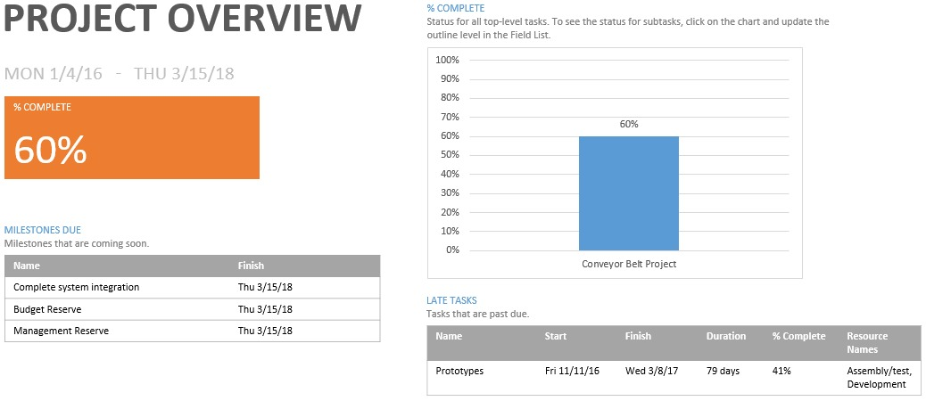
Current Status As of 1st Jan 2017

Slide 3
Current Status/ Completion
Schedule:
Project Duration: 560 days
Total delay: 30 days
Finish Date: 3/15/2018
Project running Behind the schedule.
Cost:
Cost Performance Index(CPI):0.96
Cost variance: ($30,386.40)
TCPI(1.06): For every dollar we spend we need to earn additional 6 cents on it.
Project running under budget.
Scope:
Scope is stable.
Low chance of scope creep.
Completion:
PCIB: 0.56
56% work has been accomplished to date in terms of budget.
PCIC: 0.56
56% of the cost has been spent to date of the total estimated cost at completion.

Slide 4
Comparison
Criteria | Q4 | Q4_Revised
Planned Value (PV) | $683,440.00 | $682,440.00
Earned Value (EV) | $688,384.92 | $687,253.60
Actual Cost (AC) | $717,840.00 | $717,840.00
Schedule Variance (SV) | $4,944.92 | $3,813.60
Cost Variance (CV) | ($29,455.08) | ($30,386.40)
% of Mgmt. Reserve consumed by CV (MRI) | 0.220 | 0.227
Budget at completion in cost (BAC) | $1,229,360.00 | $1,229,360.00
Variance at completion in cost (VAC) | ($52,606.85) | ($54,713.61)
Forecast estimate at completion (EAC_{f}) | $1,281,355.70 | $1,282,534.16
Cost Performance index (CPI) | 0.96 | 0.96
To Complete Performance Index (TCPI) | 1.06 | 1.06
% complete in terms of budget (PCIB) | 0.56 | 0.56
% complete in terms of exp. cost (PCIC) | 0.56 | 0.56

Slide 5
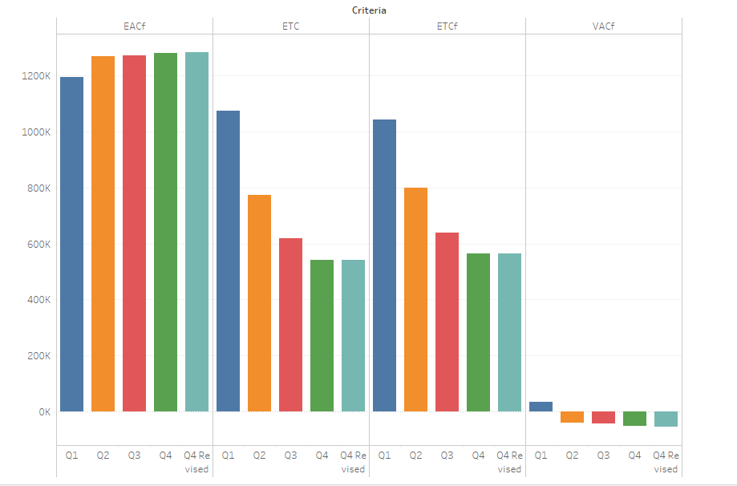
Cumulative Trends
Criteria | Q1 | Q2 | Q3 | Q4 | Q4_Revised
EAC_{f} | 1195823 | 1269508 | 1270610 | 1281356 | 1282534.16
VAC_{f} | 33536.84 | -40147.7 | -41250.3 | -51995.7 | -53174.16
ETC | 1073379 | 774824.1 | 619840 | 540975.1 | 542106.4
ETCf | 1044143 | 798787.7 | 639010.3 | 563515.7 | 564694.16

Slide 6
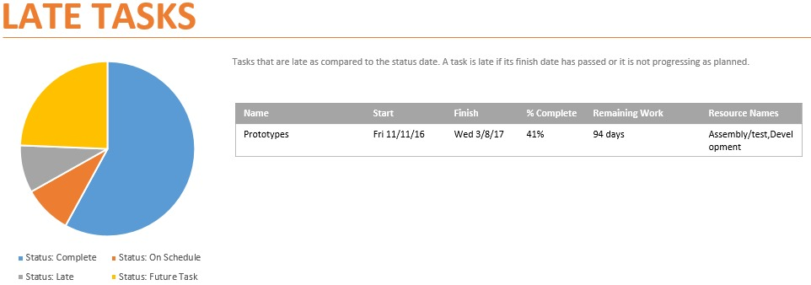
Activities to concentrate
Prototype VAC = $1,119.50

Slide 7
Risk Assessment Form
Risk Event | Likelihood | Impact | When
Raw materials cost increase | 2 | 3 | Purchasing
Failure of mechanical components | 2 | 5 | Testing Phase
Network Interface Failure | 3 | 4 | Integration Acceptance Testing
Natural Calamity | 1 | 5 | At any Phase
User inability to operate system | 3 | 4 | Post Installation
The Budget reserve is $44,540.00
Identified risk: Failure of mechanical component.
Failure of mechanical components will consume $8,368.00 with a probability of 40% over cost of impact $20,920.00

Slide 8
Problems Identified and resolutions
Problems:
Time management issues
Conflicts between team members.
Communication problems – miscommunication and misinterpretations
Multi-tasking.
Resolution Steps:
Looking out for potential problem areas – ask right questions
Having more number of meetings which run for short period of time.
Training and helping members of the team.
Avoid scope creep.
Outsourcing tasks to get back on schedule(when required).

Slide 9
Thank You

